Slide 1



Pranav_TechAssessmentPresentation - Power BI
View in Power BI
Last data refresh:
10/18/2024 7:10:05 AM UTC
Downloaded at:
10/18/2024 7:13:31 AM UTC

Slide 2
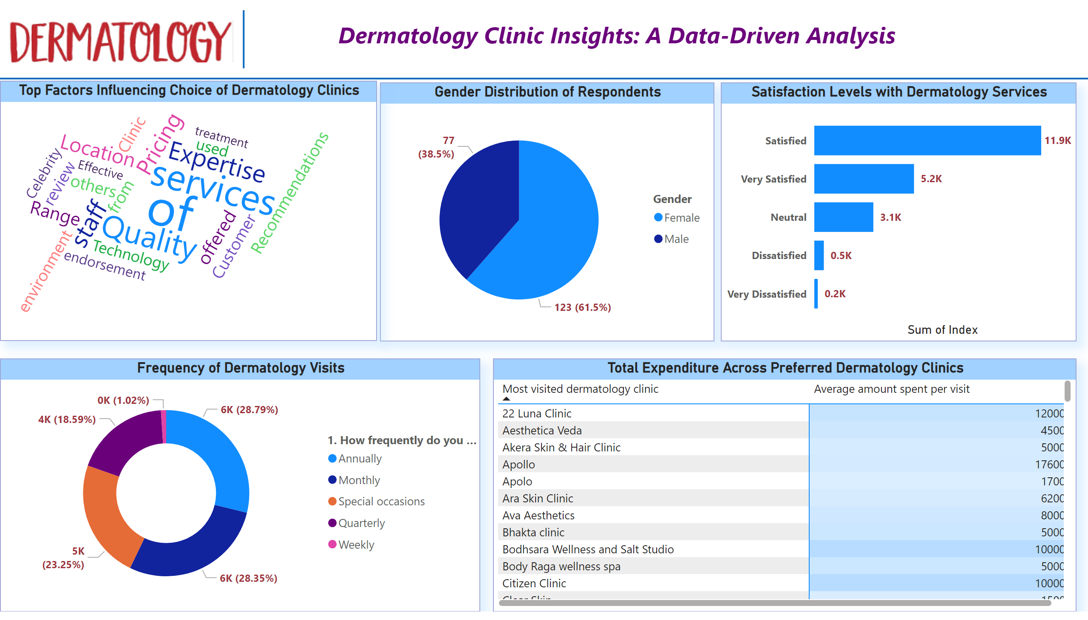
Page 1
Notes:
Gender Distribution of Respondents
No alt text provided
Satisfaction Levels with Dermatology Services
No alt text provided
Top Factors Influencing Choice of Dermatology Clinics
No alt text provided
Frequency of Dermatology Visits
No alt text provided
Total Expenditure Across Preferred Dermatology Clinics
No alt text provided
image
No alt text provided
shape
No alt text provided
textbox
No alt text provided
shape
No alt text provided

